Slide 1
Professional Issues in IT
Topic 3:
IT Project Management
Notes:
NCC Education - Title Master

Slide 2
Scope and Coverage
This topic will cover:
  IT Project Management
    What it is and why it is necessary
  IT Project Management Lifecycle
    What the project management lifecycle is
    Lifecycle phases and stages
Notes:
NCC Education - Slide Master

Slide 3
Learning Outcomes
By the end of this topic students will be able to:
  Explain what IT project management is;
  Identify the project management lifecycle phases;
  Name and explain key stages within lifecycle phases.

Slide 4
What is IT Project Management?
IT Project Management is:
“The application of knowledge, skills, tools and techniques to project activities to meet the project requirements.”
(PMI 2008:6)
“A management environment set up to ensure the delivery of a specified business product to meet a defined business case”
(Cadle & Yeates 2001:49)

Slide 5
Why Project Management?
IT projects are becoming increasingly complex
    More specialised
    Shorter deadlines
    Increasing numbers of stakeholders
    Increasingly distance based
    Tighter budgetary demands
Projects must be controlled (managed) to stand a chance of being a ‘success’
    Success measured in Time/Quality/Cost

Slide 6
Project Management Lifecycle - 1
Concerned with the management of a project
    Method123 approach
Project management methodologies
    Encompass project management lifecycle phases
    Series of techniques, tools and procedures
    PRINCE2
Exists within a systems development lifecycle
    Operation, maintenance and enhancement after project launch
      Waterfall/Spiral

Slide 7
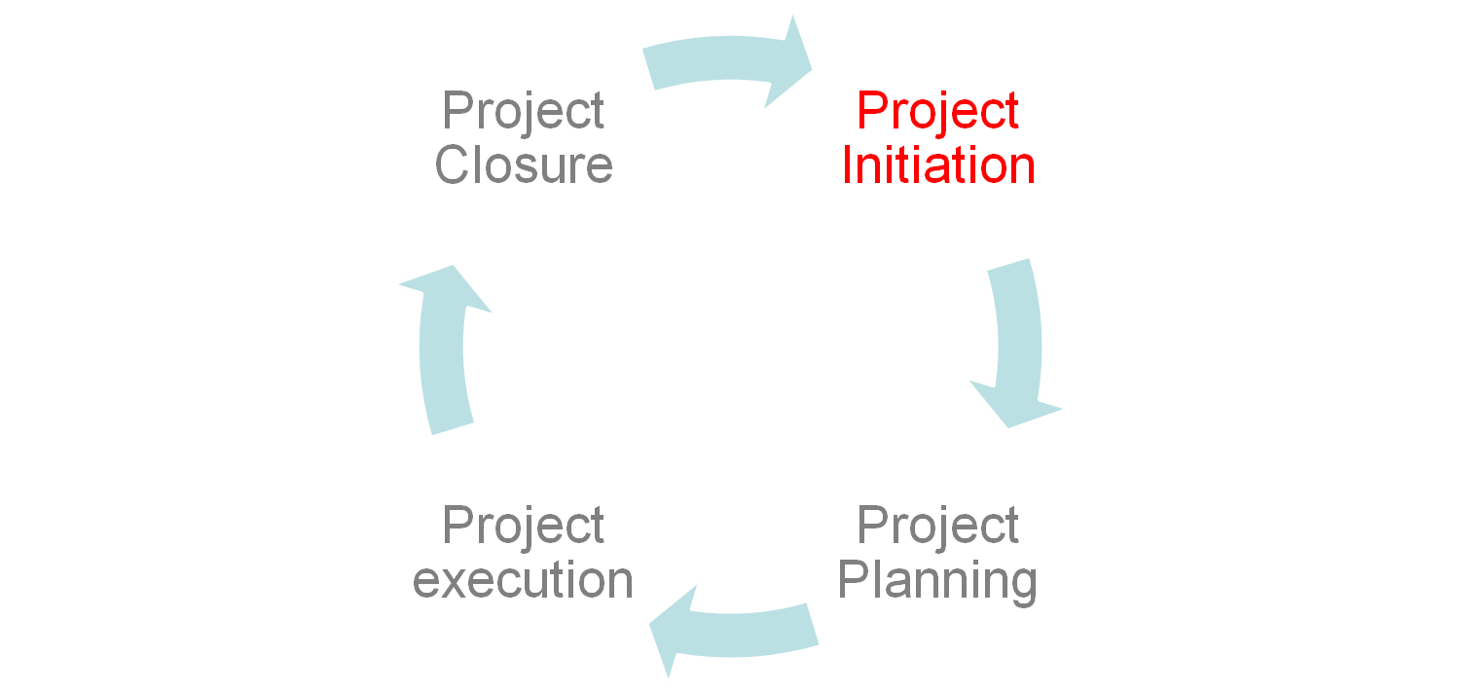
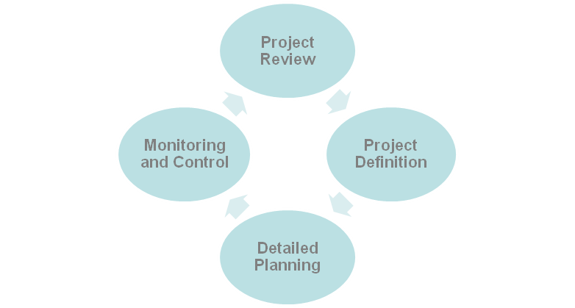
Project Management Lifecycle - 2

Slide 8
Project Management Phases
Divisions within a project
    Subsections for management, planning and control
Usually sequential although overlap can occur
Number of phases
    Dependant on project size, complexity and impact
    Each phase has multiple stages
All phases have same characteristics
    Phase end handover
    Unique focus
    Control

Slide 9
Initiation Phase
Phase 1
Defining of project:
    Objectives/scope/purpose/deliverables
Most important of all phases!
Key stages of phase
    Business Case
    Project Charter
    Draft Project Plan
    Phase Review

Slide 10
Business Case
1st step in whole project lifecycle
Create business case
    Identify alternative solutions
    Justify start up of project
    Identify business problem/opportunity
    Costs/benefits
    Recommend solution
Documentation referred to throughout project
Project success measured against business case

Slide 11
Project Charter
Defines project/ specifies boundaries/ sets scope
Also known as
    Letter of contract/ letter of agreement/ project constitution
One page document
Powerful communication tool
    Big picture
    Common vision
3 stage approach
    Draft/ version 1/ updates

Slide 12
Draft Project Plan
Basic summary project plan
Initial identification of
    Project objectives
    Project team
    Equipment
    Scheduling
    Assumptions
Helps evaluate at this stage whether a project is potentially achievable

Slide 13
Initiation Phase Review
To close out initiation phase
Report on achievements to date
    Schedule
    Budget
    Issues
Form or report format
Measure deliverables
Gain approval to start planning phase

Slide 14
Planning Phase
Phase 2
Creation of credible project plans
Establish project managerial foundations
Uses project requirements identified in phase 1
    Quality of phase 1 documentation essential
Documentation used for monitoring and progress tracking
Essential management recognise importance of phase

Slide 15
Planning Phase – Key Stages
Key Stages of phase:
    Project Plan
    Resource Plan
    Financial Plan
    Quality Plan
    Risk Plan
    Acceptance Plan
    Communication Plan
    Procurement Plan
    Phase Review

Slide 16
Project Plan
Detailed document essential to project
Statement of how objectives will be achieved
Provides baseline for monitoring progress
Identify and schedule phases/activities/tasks
Contains project prerequisites and assumption lists
Set timeframes/milestones
Daily measuring of actual vs. planned progress
Finalise resources

Slide 17
Resource Plan
Also known as resource management plan
Essential comprehensive document
Necessary for budgeting/forecasting
Identification of all project resources
    Team skills/roles and responsibilities
    Equipment/types and quantity
    Materials
Timelines for resources required

Slide 18
Financial Plan
Finalise project budget
Used to measure ‘success’
    Expenditure vs. projected
    Must be realistic!
Itemises expenditure areas
    Labour/equipment/materials
Includes a breakdown of finances
    Each stage of project

Slide 19
Quality Plan
Vital for success of project
Finalises milestones for project quality reviews
Concerned with both internal and external targets
    Internal company reviews/external customer reviews
Ongoing measure of project quality
    Reduction of nasty ‘surprises’
Imparts customer confidence
    Consultation throughout process

Slide 20
Risk Plan
Identification of potential/ real project risks
Plan for risk reduction
    Monitor and control
Essential to a projects success
Reviewable/ reworkable throughout project life
Further detail in Topics 7 and 8

Slide 21
Acceptance Plan
Also known as success plan
Defines measurable tasks required to be completed for project to be accepted by client/stakeholders
Formal agreement document
    All parties know where they stand
    Aim to negate risk of client dissatisfaction
Should be reworked as criteria changes
Includes:
    Deliverables/ testing/ criteria/ standards/ milestones/ payment plans

Slide 22
Communications Plan
Exists to inform
Ensure all stakeholders receive clear, up-to-date information at regular intervals
    Remove opportunity for confusion/excuse
Goes beyond the project
    Can effect organisation at strategic level
Enables regular feedback
Opportunity to continually improve communication

Slide 23
Gantt Charts - 1
  One of the oldest and most useful planning tools
  Can be used to show both planned and actual progress of project tasks
  Very easy to read and useful for all types of plan both at high and detailed levels
  The horizontals axis represents time
  The vertical entries maybe tasks, resources or anything else that needs to be controlled over a time duration.

Slide 24

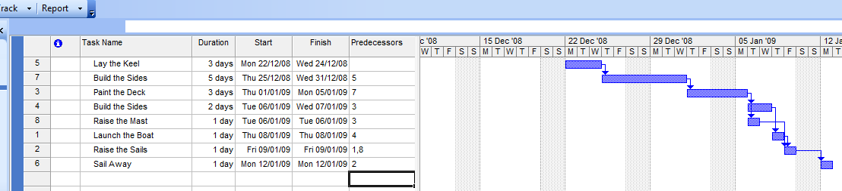
Gantt Charts - 2
Bar represents time
This could be a list of tasks or resources

Slide 25
Procurement Plan
Also known as a purchase plan
Opportunity to plan ahead purchasing of products/services needed for project
Defines timeframes
Justifies need
Reduces chance of project halting due to lack of supplies

Slide 26
Phase Review
Exists to report progress to date
    Client/stakeholders/project team/management
Documented process for end of project review
Identifies and records
    Project on schedule to date (or not!)
    Any issues/ risks identified
    Resolutions
Aim
    Receive approval to continue

Slide 27
Execution Phase
Phase 3
Performance-based phase
Building and management focused
    Building project deliverables
    Managing project for success
    Client handover
Longest phase
    Time and resource heavy
Invoking planning phase documentation

Slide 28
Execution Phase – Key Stages
Key stages of phase
  Build deliverables
  Perform
    Time Management
    Cost Management
    Quality Management
    Change Management
    Risk Management
  Perform
    Procurement Management
    Communications Management
    Phase Review

Slide 29
Time Management
Exactly as name suggests
    Manages and measures time within project
Done well, time management has huge influence on delivering project to schedule
    Done poorly and can absolutely effect success of project
Essential to record time spent on tasks
    For later tasks on this project
    For future projects where similar tasks will be undertaken
    For interim payments to team members within project

Slide 30
Cost Management
Essential to monitor and control cost throughout life of project
    Failure resulting in increased budget = client and management dissatisfaction
    Potential strategic level impact
Aim
    To deliver project on cost

Slide 31
Quality Management
Ensures all deliverables attain required standard
    Lack of quality jeopardises project success and organisation at strategic level
      Wastes time/resources/budget
Sets quality targets
    For project/project team/deliverables
Monitors
    Proactive identification of quality issues
Aim
    To resolve any quality issues that may impact project success

Slide 32
Change Management
Procedure for implementing change once project has begun
    Identification of required change
    Measurable potential effect(s) of change
    Control the process of implementing the change
    Record change details
    Manage any impact
    Review decision
Aim
    To minimise the impact of any change on a project
    To manage client expectations throughout project

Slide 33
Risk Management
Monitoring and controlling of risk within a project
It is essential that it is taken seriously.
Often, a specialist Risk Manager is assigned to project
Attempts to pre-empt possible risks with plan
Aim
    To minimise the impact of risk on project
We will focus on risk management in Topic 7 & 8

Slide 34
Procurement Management
Managing the purchase of goods/services from suppliers during a project is essential
    Ensuring goods/services are available when required
      Poor procurement management can result in a project stalling or falling over
    Goods/services match requirements
    Procured within budget constraints are essential or renegotiation will be necessary
      Costing time/money
  Aim
    Keeping project on track

Slide 35
Communications Management
Managing expectations through communication
    When people feel informed and included processes often run more smoothly
Informing interested parties about developments
    Not as easy as it sounds. Different interested parties require different information
    Management of company developing project will have access to information that a client should never see.
    Accountants will be interested in the bottom line, not excuses as to why overspend occurred.
Aim
    Keeping all parties informed with the right type of information

Slide 36
Execution Phase Review
Internal review of success of project
    Ideally going beyond time/cost/quality
      Project team success: Structure/compatibility/expertise
    Strategic impact of project
    Communication success
Documenting of findings
    Ensure completion of detailed documentation of all findings associated with project
      Important for future projects
      Aids organisation in future decision making

Slide 37
Closure Phase
Final Phase (in four phase approach)
Formal project closure
Documentation of everything necessary to close out project
    Deliverables met
    Client approval gained
    Handover process
    Any payment due (if penalties incurred due to over-run)
Key Stages of phase
    Perform project closure
    Project review

Slide 38
Perform Project Closure
Official handover of all project deliverables to client
Achieve client satisfaction
Record & collate all information generated throughout project life
Confirm that all suppliers have been paid

Slide 39
Project Review
Review of performance throughout project lifecycle
    From beginning to end/ internal and external
Can be undertaken internally or organisation may employ external expert for review
Aim
    That project can be judged a success!

Slide 40
References
  Cadle, J. & Yeates, D. (2001). Project Management for Information Systems. FT Prentice Hall.
  Dalcher, D. & Brodi, L. (2007). Successful IT Projects. Thomson.
  Project Management Institute (2008). A Guide to the Project Management Body of Knowledge (PMBOK® Guide). 4th Edition. Project Management Institute.
  Schwalbe, K. (2006). Introduction to Project Management. Thomson.
  www.method123.com
  www.ogc.gov.uk

Slide 41
Topic 3 – IT Project Management
Any Questions?
Notes:
NCC Education - End Slide Master

